Slide 1
Comparing Multiple Instance Learning Video Segmentation Techniques
Alex and Shawn
Notes:
In this paper, we experiment different techniques in the area of Multiple Instance Learning. We are interested in this particular area, because [next slide]

Slide 2
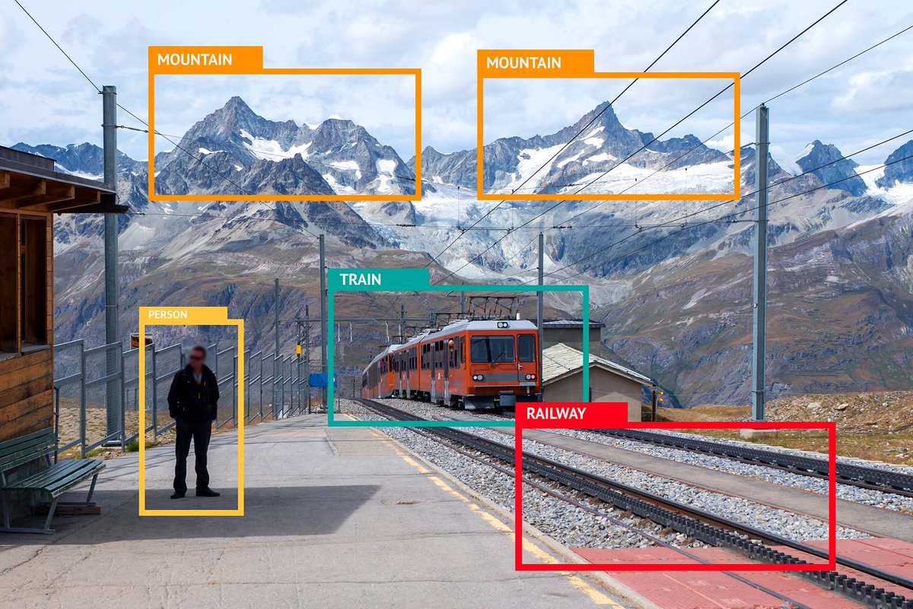
Labeled Data is Expensive
Notes:
Labeled Data is expensive!
As data scientists, we don’t always have access to well organized datasets. And therefore, we feel that it is important to investigate new methods of training our models where we can achieve the same (or better) results with less data. We found a field within AI called “Multiple Instance Learning” that solves this problem - that’s the focus on our paper.

Slide 3
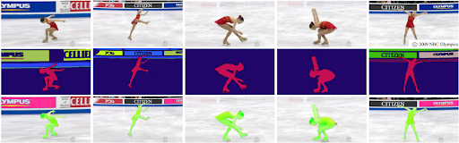
Video Segmentation
Notes:
We were also interested in Video Segmentation. The reason is that there are so many research on static images. For example, MS-COCO, ImageNet...the list goes on forever. But there’s not as much research on Video Segmentation.
And so, we combined these two motivations together.

Slide 4
Multiple Instance Learning (MIL)
Whether the image contains the object?
Notes:
Multiple Instance Learning (MIL for short) refers to a type of supervised learning problem where the model learns to predict instance labels given supervision of whether the image contains the object(s).

Slide 5
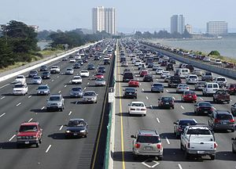
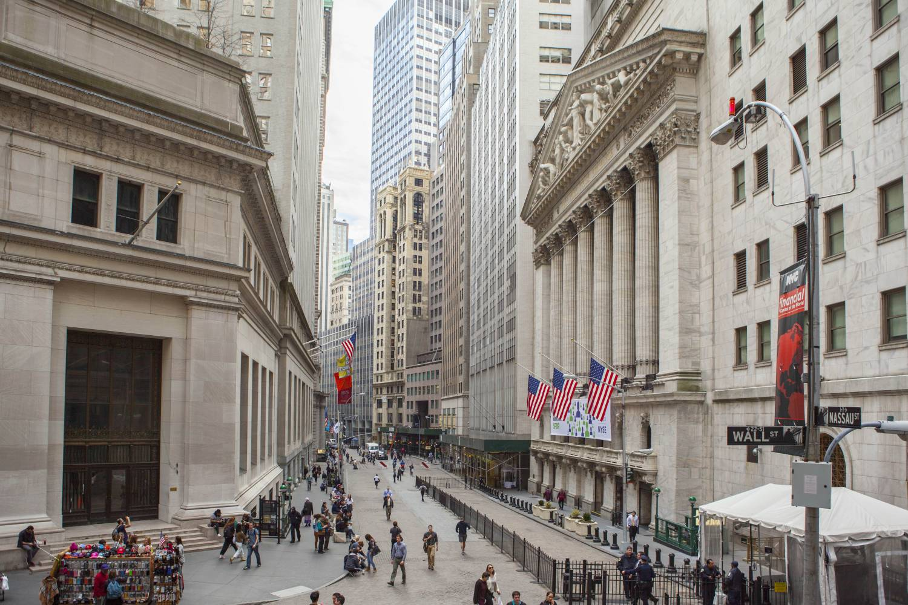
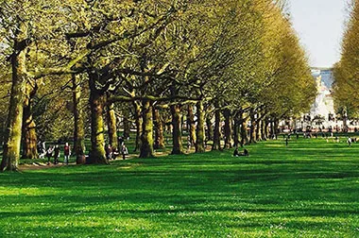
Multiple Instance Learning (MIL) Example
‘Has_car’ or ‘No_car’?
‘Has_car’
Model
‘No_car’
Notes:
Here’s an example:
Let’s say we are concerned about whether an image has cars or not.
We train our model with images with labels of either ‘has_car’ or ‘no_car’.
In the testing phase, we provide an image without labels, and ask the model - does this image have cars?

Slide 6
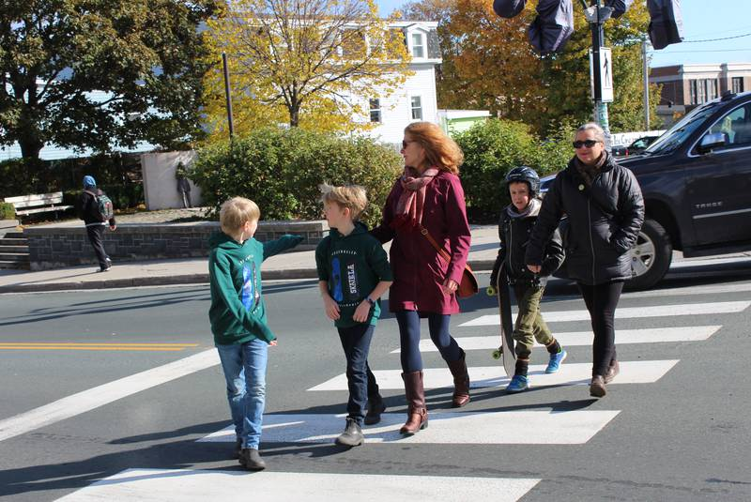
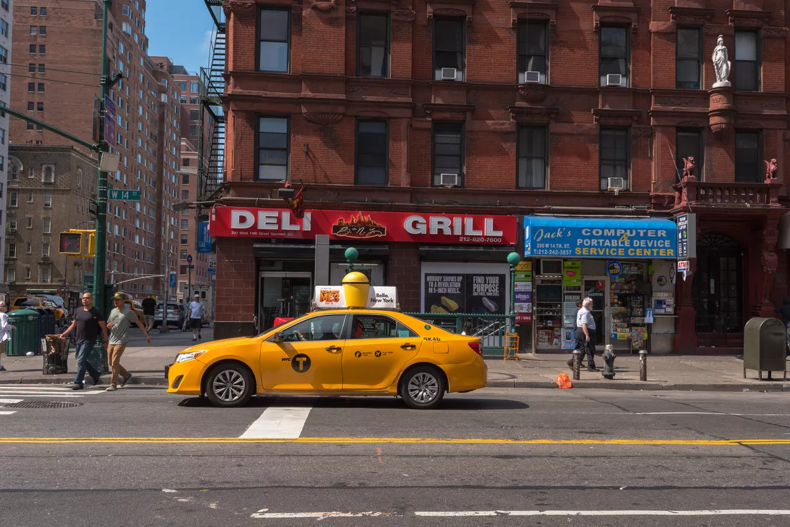
Goals
KITTI Dataset - does the image contain pedestrian(s)?
AiSkyEye Dataset - does the image contain car(s)?
?
?
Notes:
Goals.
We want to evaluate MIL techniques against two video sequence datasets.
The first dataset is KITTI. In this dataset, we ask the question - does the image contain pedestrians?
The second dataset is AiSkyEye. In this dataset, we ask the question - does the image contain cars?
[:] = 1min 15sec

Slide 7
Methods
Image MIL segmentation methods based on pretrained classifiers:
Fully Convolutional Multi-Class Multiple Instance Learning, D. Pathak et al. (MIL-FCN)
Classifying and segmenting microscopy images with deep multiple instance learning, O. Kraus et al. (Noisy-And Pooling)
Self-produced Guidance for Weakly-supervised Object Localization, X. Zhang et al. (SPG)

Slide 8
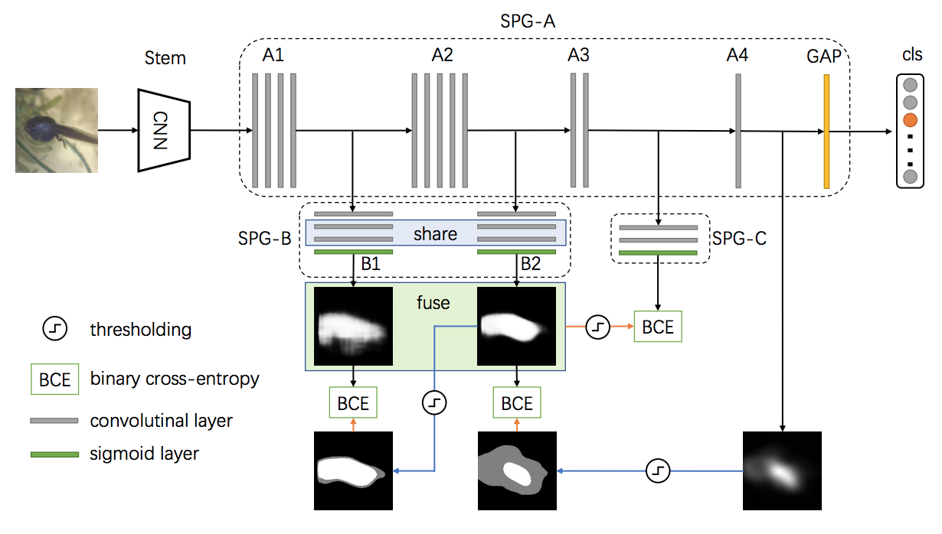
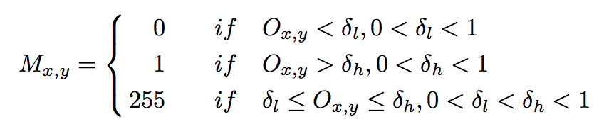
SPG
Stage-wise guided mask:
Backbone CNN: Inception_V3
A1, A2: DoubleConvTranspose2D (upsampling)
A3,B1,B2: DoubleConv
A4: 1x1xK Conv layer (for generating heatmap)
Gradient of ignored pixels are not calculated
Loss: CrossEntropy for class labels + BinaryCrossEntropy for stage-guided masks
Code: https://github.com/shawn3298317/SPG.git

Slide 9
Experiments (SPG model)
Hyperparms: 10 Epoch, SGD(0.001, momentum=0.9, weight_decay=5e-4), BS(16)
Test set Performance:
Test Loss: 0.578
Class Classification Accuarcy: 0.883
IoU for SegMask: 0.606
Notes:
Experiments - Shawn

Slide 10
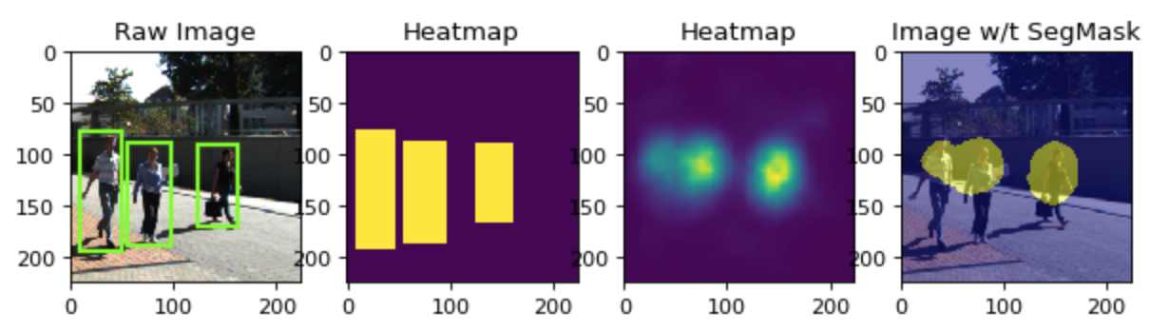
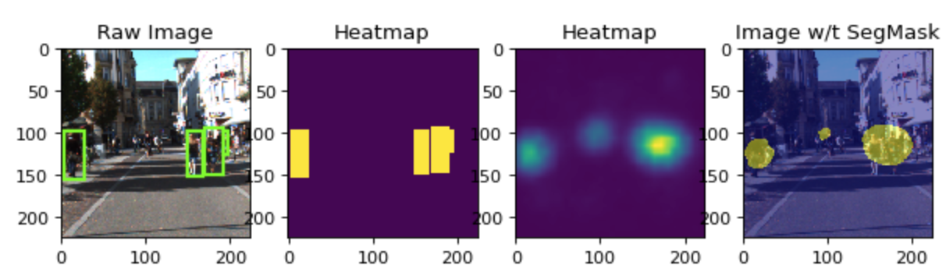
Results SPG -- KITTI - Good Example

Slide 11
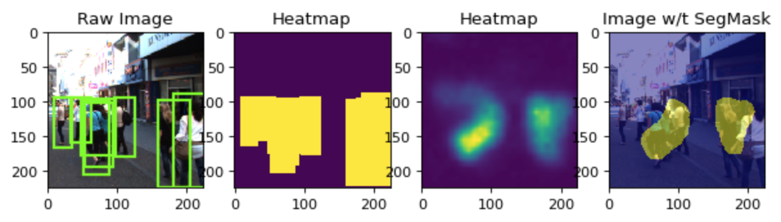
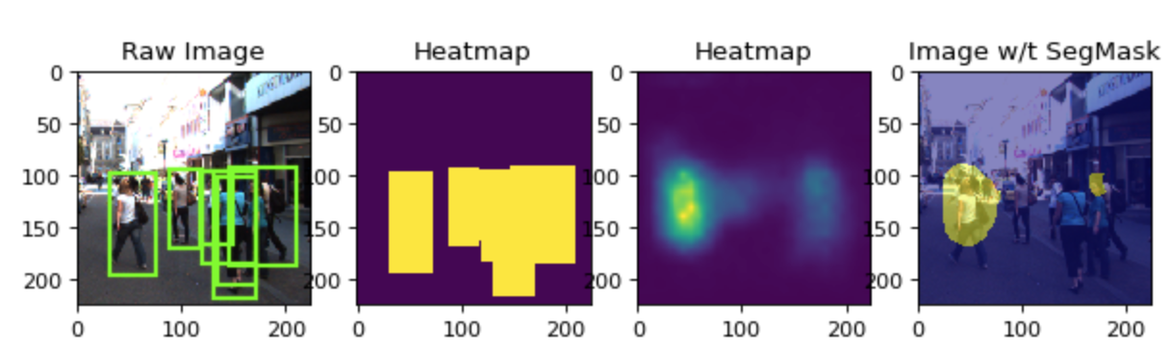
Results SPG -- KITTI - Bad Example

Slide 12
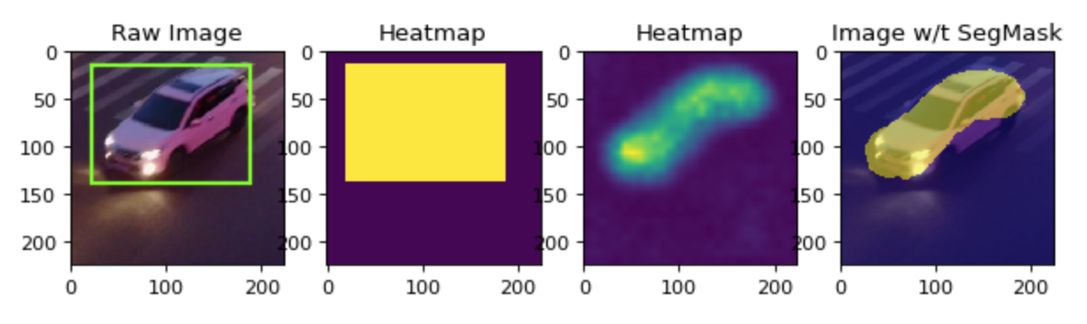
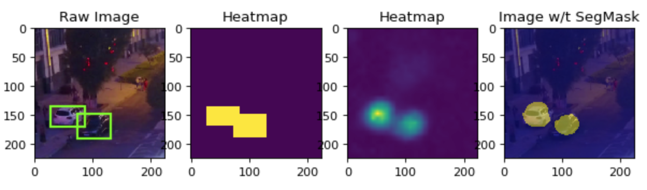
Results SPG -- AiSkyeEye - Good Example

Slide 13
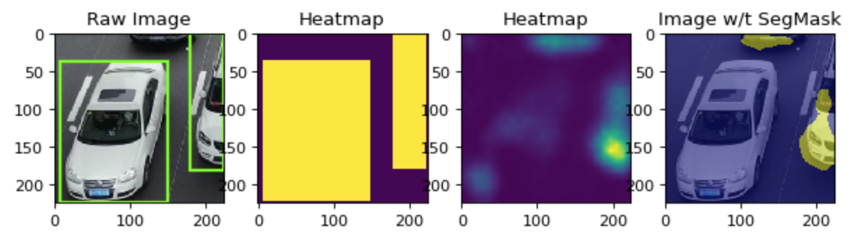
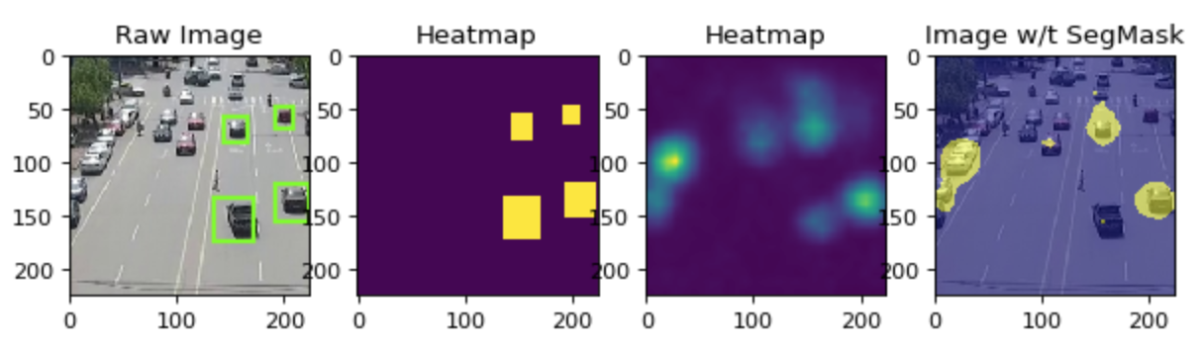
Results SPG -- AiSkyeEye - Bad Example

Slide 14
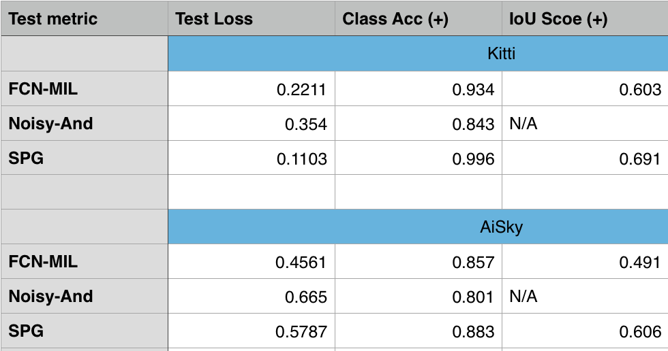
Results

Slide 15
Discussion
Notes:
Discussion of results (Is the method successful? Are your results satisfactory? What are the limitations of the method used? Did you improve on the state-of-the-art? Give a critical evaluation.) - Shawn

Slide 16
Conclusion
In this project:
3 MIL models on 2 Datasets -> Very good results
In the Future:
Improve s.o.t.a MIL methods (occluded objects/non-salient objects)
Adopting proposed methods to solve problems like (difference detection/anomaly detection)
Notes:
In conclusion, We trained three different MIL models against two different video segmentation sequence datasets. In each dataset, the object of focus is different, but we still achieved very good results in both.
In the future, we want to dig deeper in the segmentation section and achieve the same (or better) results on multi-class datasets. As a stretch goal, we want to adapt the techniques in this paper to achieve near-real time video segmentation to make our methods more practical.
[.] = 25 sec

